Slide 1
Operation Analytics and Investigating Metric Spike
Project Done By: Sayan Kashyap

Slide 2
Project Description
This project aim is to leverage operational analytics for end to end analysis of a company’s operations, identify areas for improvement and provide actionable insights to cross functional team.
This project will also involve analyzing metric spikes in daily engagement, sales, investigating their causes and providing insights to address any dips in these metrics.

Slide 3
Approach
As a Lead Data Analyst at a company like Microsoft, we will be provided with various datasets and tables and our task will be to derive insights from this data to answer questions posted by different departments within the company which can help improve the company’s operations and understand sudden changes in key metrics.
First of all we create the database and tables by using the provided dataset in MySQL Workbench then by using SQL queries we analyze the requirements asked by the different departments within the company.

Slide 4

Tech-Stack Used
MySQL Workbench v8.0.33: It makes managing and designing databases easy with its user-friendly interface and helps us with visually design databases, build queries, and manage performance without needing to use complex commands.

Slide 5
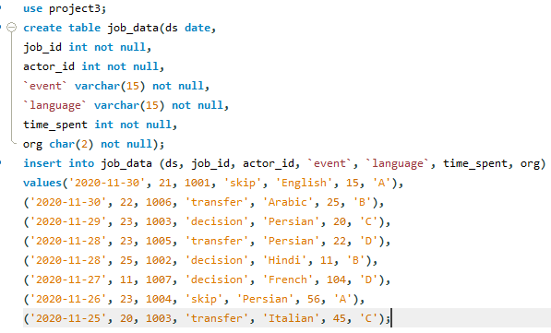
Case Study 1: Job Data Analysis

Slide 6

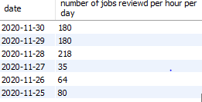
A. Jobs Reviewed Over Time:
SQL Query:
Output:

Slide 7
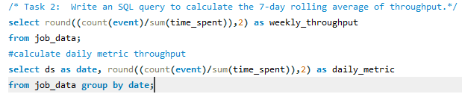
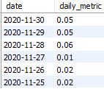

B. Throughput Analysis:
SQL Query:
Output:

Slide 8
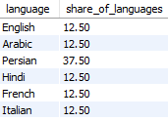
C. Language Share Analysis:
SQL Query:
Output:

Slide 9
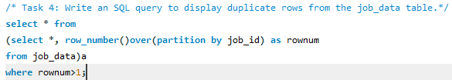

D. Duplicate Rows Detection: SQL Query:
Output:

Slide 10
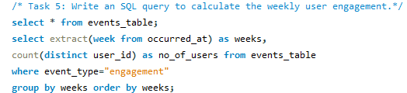
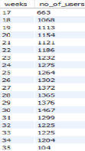
Case Study 2: Investigating Metric Spike
A. Weekly User Engagement:
SQL Query:
Output:

Slide 11
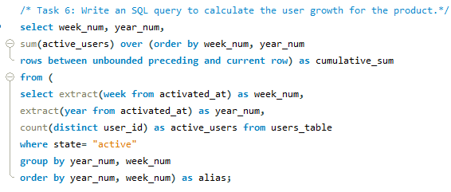
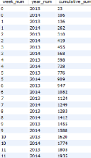
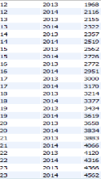
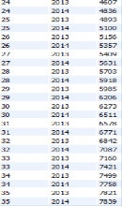
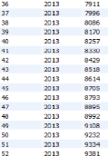
B. User Growth Analysis:
SQL Query:
Output:

Slide 12
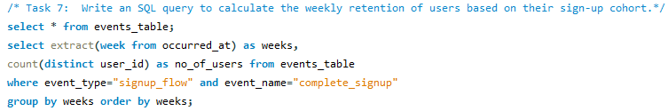
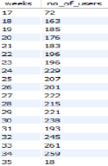
C. Weekly Retention Analysis:
SQL Query:
Output:

Slide 13
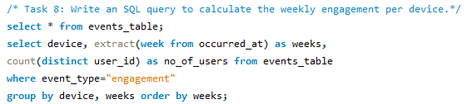
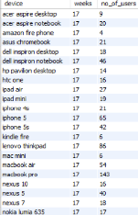
D. Weekly Engagement Per Device:
SQL Query:
Output:

Slide 14
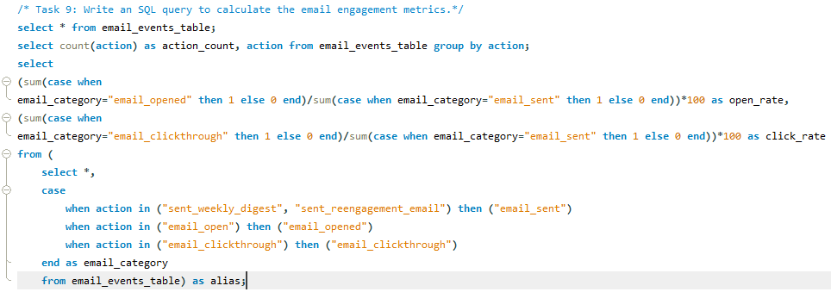

E. Email Engagement Analysis:
SQL Query:
Output:

Slide 15
Insights
The number of jobs reviewed per hour per day in November 2020 are high on some days and low on other days.
7 day rolling average for throughput allows to observe trends over time.
Persian language having the highest share.
There are couple of duplicate rows in the table.
User engagement seems to peaked around week 30.
User growth has generally been positive over time.
Weekly user retention shows a gradual decline over time.
Engagement varies across different devices and weeks, some devices shows higher engagement than others.
The email engagement metrics shows an open rate of approx. 33.58% and a click rate of about 14.79%.

Slide 16
Result
This project help me to understand about My SQL functions as well as some advanced SQL concepts like Windows Keys, etc.
In this project, SQL queries used to extract insights from provided datasets by which we analyze various requirements like rate of job reviews, share of languages, patterns of user engagement on weekly basis, growth of users etc. asked by the different departments within the company.

Slide 17
Conclusion
This project helped me understand how important Operational Analytics is for an organizations as it helps in identifying and understanding areas where improvement is required.
In this project, I was also able to get insights about various questions like rate of job reviews, share of languages, patterns of user engagement on weekly basis, growth of users etc.

Slide 18
Thank you

